Slide 1
Global PPC Award Template
Updated Q4 2012

Slide 2





Background/Brief
J&J Paid Search Toolkits
Background
J&J Digital program workshop – indentified limited search activity across markets due to the central and local market brand managers having low search knowledge.
Brief
Increase search knowledge of central client, local market brand managers and the Carat team.
Increase the search activity in each market whilst implementing best practice principles and consistency across each market.
Paid Search

Slide 3

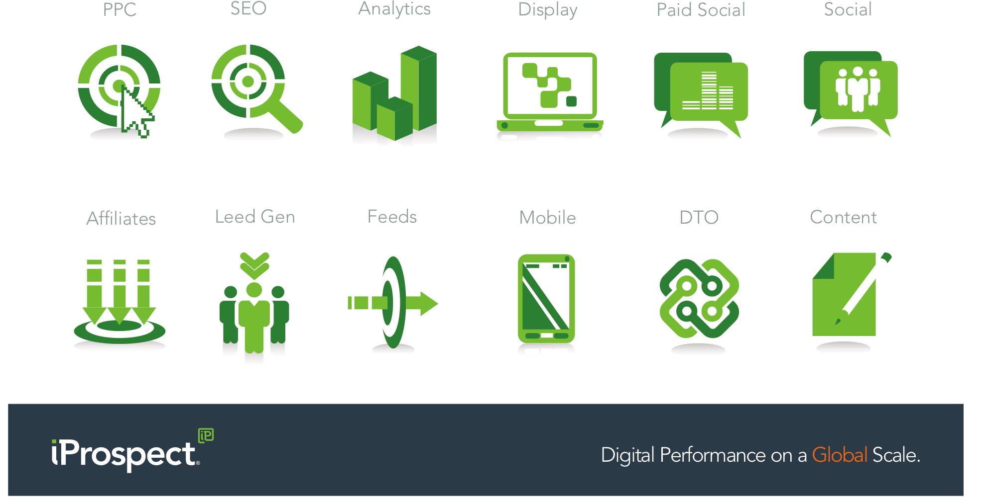
Challenge
Increasing Search Knowledge & Activity
Paid Search???!!
Challenges
Central client and local market brand managers had low search knowledge.
Carat team had low level search knowledge.
The central client could not tell the local brand managers how much budget should be allocated to paid search.
Local brand managers unwilling to spend more in search due to lack of knowledge of search

Slide 4
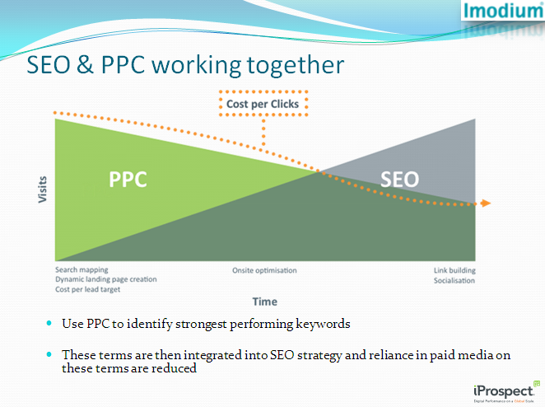
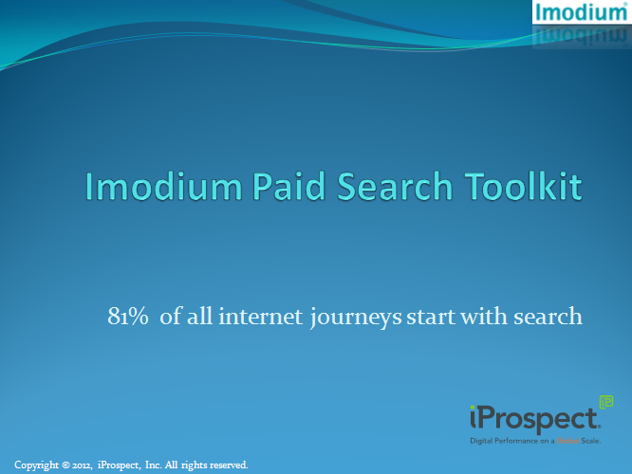
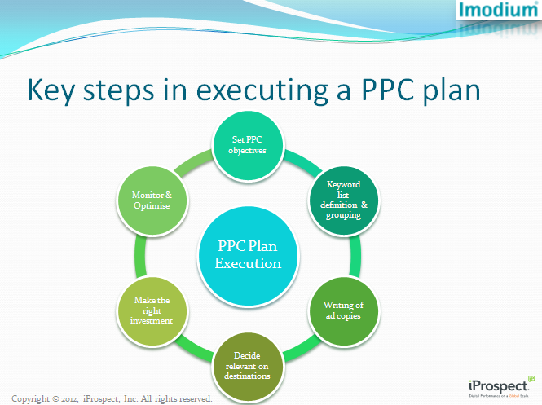
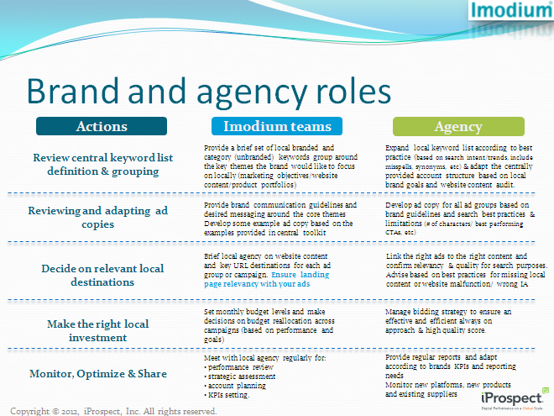
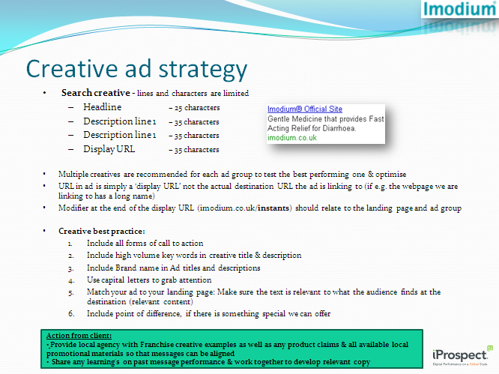
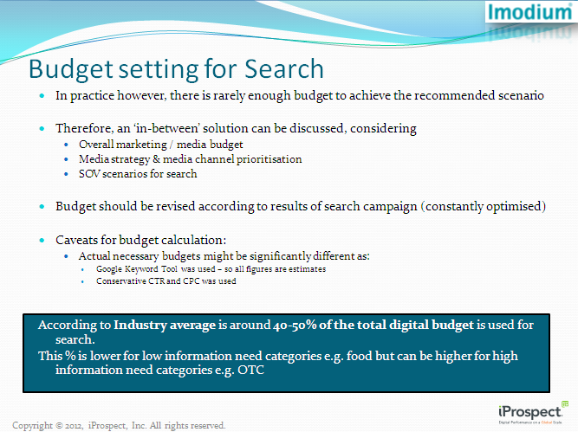
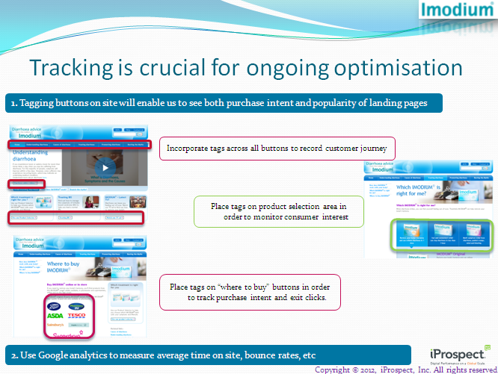
Strategy
Building the Search Toolkit
Strategy
Working with the Carat team, a search toolkit was created for J&J Clean and Clear. The toolkit educated the local brand managers in paid search.
Whilst working on the toolkit with the Carat team, we were also educating the Carat team in paid search.

Slide 5
results
Increased Search Knowledge & Activity
The toolkits increased the search knowledge of the central clients and the local market brand managers, with search activity increasing across each market:
Consistency and best practice applied to search campaigns across all markets.
One toolkit has led to 4 toolkits which have resulted in improved search campaigns for the brands that the toolkits were produced for.
Imodium Global Franchise Director, Marni Allen
“Working with J+ and iProspect on this project has helped me reach a whole new level of understanding of Search, and I hope it has the same impact in the markets.’’
Imodium Germany Brand Manager, Maike Sternal
“We really want to start using the toolkit & implementing the learning’s.’’

